Slide 1

NUnit Boot Camp
Getting started with the NUnit automated testing framework

Slide 2
What will we learn?
How to get NUnit v. 2.1 onto your machine
Basic NUnit terms and concepts
“Physician, test thyself!” -- NUnit on NUnit
How to run the NUnit test runners (console and GUI)
NUnit in our real world – DRRS
Congratulations! You have built-in model tests.
Debugging basics
… and maybe some “Hello, NUnit!” TDD.
Save your ink! I will email handouts to you.

Slide 3
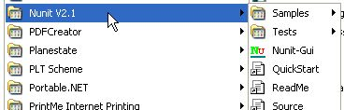
Getting Started with NUnit
See if NUnit is already on your machine
  DRRS uses Version 2.1.
  Look in [Start|Programs|Nunit V2.1]
  You should see something like the picture at right.
If you do not have it, download and install NUnit.
If you do not have it by now, download the NUnit v 2.1 Source Code and unzip it where you want it.

Slide 4
Extra Credit
A Credit: Create batch files somewhere in your PATH to start your nunit-console and GUI.
  @echo OFF
  "C:\Program Files\NUnit V2.1\Bin\nunit-console.exe" %1 %2 %3 %4 %5 %6 %7 %8 %9
  @echo ON
  @echo OFF
  "C:\Program Files\NUnit V2.1\Bin\nunit-gui.exe" %1 %2 %3 %4 %5 %6 %7 %8 %9
  @echo ON
A+ Credit: Add your NUnit Bin directory to your PATH.
A++ Credit: If you’re using Visual Studio.NET, download and install TestDriven.NET (used to be NUnit Add-in).

Slide 5
Introducing xUnit and NUnit
Original framework was SUnit, developed for Smalltalk by Kent Beck
Versions available for most programming languages (CppUnit for C++, JUnit for Java, PyUnit for Python, NUnit for .NET etc)
Simple concepts
  Test fixture: a class that contains one or more test methods
  Test suite: a collection of tests based on user preference.
  Deprecated, but still used in NUnit itself.
  Test method: a method that executes a specific test
  Test runner: an application that finds and executes test methods on test fixtures
  Assertion: a Boolean expression that describes what must be true when some action has been executed
  Expected Exception: the type of an Exception we expect to be thrown during execution of a test method
  Setup: Code that is run before every test method is executed (e.g., logging in as a particular user or initializing a singleton)
  Teardown: Code that is run after every test method has finished (e.g., deleting rows from a table that were inserted during the test)

Slide 6
NUnit Attributes
  [TestFixture]
  [TestFixtureSetUp]
  [TestFixtureTearDown]
  [Test]
  [SetUp]
  [TearDown]
  [ExpectedException(typeof(Exception))]
  [Ignore(“message”)]

Slide 7
Required attributes
  [TestFixture]
    Used to indicate that a class contains test methods
  [Test]
    Used to indicate that a method within a test fixture should be run by the Test Runner application

Slide 8
Test Setup Attributes
  [SetUp]
    Used to indicate a setup method should be run before each of the tests
  [TearDown]
    Used to indicate a tear down method should be run after each test is run

Slide 9
Fixture Attributes
  [TestFixtureSetUp]
    Used to indicate a setup method that will be run once; before all other tests. This is the first method called before the tests are started.
  [TestFixtureTearDown]
    Used to indicate a tear down method that will be run once, after all other tests have run. This is the last method called after all tests have finished.

Slide 10
Other Attributes
  [ExpectedException(typeof(Exception))]
    When you want an exception to be thrown
    Will only pass if exception type was thrown
  [Ignore(“Not ready for primetime")]
    Used when a test is not yet ready, or you don’t want the test to be run

Slide 11

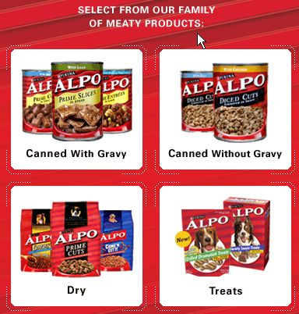
They ate what?!
About ALPO’s
  “Can Tastings”
Tasting - noun: taking a small amount into the mouth to test its quality
NUnit has its own NUnit tests.
  “Eat your own dogfood.”
  “Physician, test thyself!”
We’re not talking
this one →
We’re talking this one!

Slide 12
Recursive Descent
Let’s run some NUnit tests on NUnit.
  GUI demo
  Console demo

Slide 13
Use the Source, Fluke!
Fluke - noun: “a stroke of luck”; Your new nickname if you don’t do good unit and acceptance testing.
Need examples? Look no farther than NUnit’s source.
NUnit provides good models that can help you get started with writing tests and test fixtures.
These are serious tests, used to test a real product.
Demo: Look at some NUnit Source

Slide 14
A Bit about Tests
1

Slide 15
A Bit More About Tests
Most NUnit tests are pretty simple.
Test for “worst first” conditions. What’s likely to really hurt? Test for that. Remember the “80/20” rule!
Do “Just Enough Testing.”
  Not too little – Create real tests that do something or don’t bother.
  Not too much – It’s probably not necessary to test every property; but, if you do a bunch of stuff in there, ….”
Later, add tests in response to “issues.”

Slide 16
Let’s Have a Look! (1)
Demo: Examine nunit.tests.dll.csproj:
  Look at the References
    You will need nunit.framework.dll
    You may need others – don’t worry, your compiler will tell you!
  Look at AssertionTest.cs
    TestFixture
    Setup
    Test: AssertEquals
    Test: AssertString
  Look at ConsoleFixture.cs
    Test: FixtureName

Slide 17
Let’s Have a Look! (2)
Demo (cont’d):
  Look at ConsoleRunner.cs
    Test: XmlResult (a bit more involved)
    Helpers: createProcess() – not a test
  Look at XmlTest.cs
    Helper: SchemaValidator()
    Test: TestStream()
  Look at ProgressBarTests.cs
    Scan: example of how to test a WinForms GUI control
  Mock Objects, Mock Testing – advanced topics, but some support is provided, particularly in V 2.2.

Slide 18
Our Real World: DRRS
Demo: DRRS
  Run NUnit on DRRS
  Explain our NUnit stoplight:
    Red: test failed
    Yellow: test ignored or not run
    Green: test succeeded
  Explain the NUnit GUI panels
    Errors and Failures
    Tests Not Run
    Console Error
    Console Out

Slide 19
NUnit Debugging
You can do it the hard way
… or you can do it the easy way.
And for Zen travelers, we have the middle way!

Slide 20
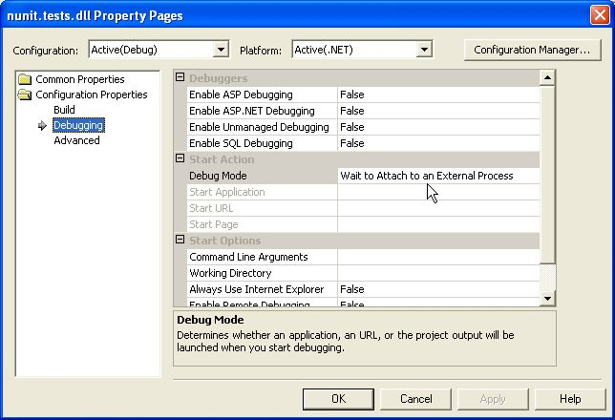
Debugging the Hard Way (1)
Project setup:
  Locate your tests project
  Display project Properties
  Open Configuration Properties
  Select Debugging
  Set Debug Mode to “Wait to Attach to an External Process”

Slide 21
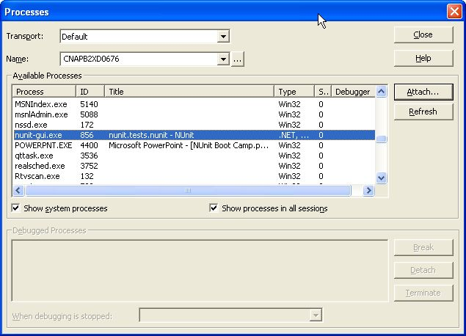
Debugging the Hard Way (2)
Attach to process
  Build your assemblies.
  In VS.NET, set starting breakpoints.
  Run nunit-gui, loading your test assembly (or NUnit Project).
  [Debug|Processes...]
  Attach, OK, then Close.
  Run your tests in the GUI.
  Take a break!
    (No, not that kind!)
NUnit Project: advanced topic
not covered in this class.

Slide 22
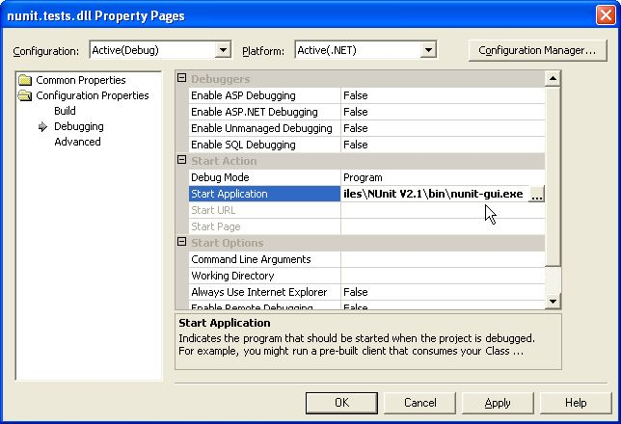
Debugging the Slightly Easier Way
Set nunit-gui as your startup process (you probably shouldn’t do this with DRRS, though).
  Locate your tests project
  Display project Properties
  Open Configuration Properties
  Select Debugging
  Set Debug Mode to “Program”
  Set Start Application to your nunit-gui location

Slide 23
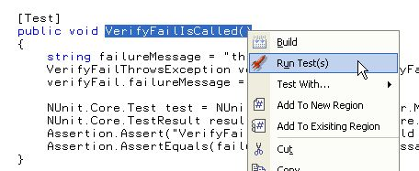
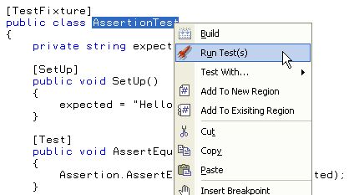
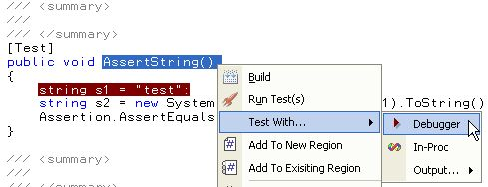
The Easy Way: Test-Driven.NET
Did I mention A++ Extra Credit?
Testing and debugging could not be much easier.

Slide 24
Gotchas
Configuration file locations
  RTFG Search Google for “nunit web.config app.config”
Watch out for Shadow Cache!
  Shadow copy cache "causes" weird debugging problems
Interactions with legacy code
  NUnit != BTF (Behemoth Testing Framework)!
  If your object model is not clean, retrofitting is difficult.
Bottom line:
  When you get serious, read the NUnit documentation.
  Don’t forget to RTFG!
  A++ Credit: Learn some google hacks! What are those? Well, just RTFG for “google hacks” but skip all the book stuff (the book is OK, though)!

Slide 25
NUnit Resources
Nunit.org
Nunit V.2 for People Who Can’t Cook
Test-Driven Development in .NET
NUnit Tip: Debugging your unit tests
Adventures in C#: Using NUnit
A++ Extra Credit: Get and read Ron Jeffries’ book, Extreme Programming Adventures in C#!
The above resources are URL’s. [Ctrl-Click] to activate.

Slide 26
Hello, NUnit!
Iff we have time, ….
Let’s do an experiment in Test Driven Development (TDD)!
Specifications:
  We want to say “Hello, NUnit!”
  We want to say it in a text string.
  We want to say it in XML.
Write your test first.
“Do the simplest thing that can possibly work.”

Slide 27
Finis – Q & A
Go ye C# and conquer (I mean test)!
(This only makes a twisted sort of sense if you recognize Forth as an archaic [but sometimes still useful] programming language)
At leatht after my Prolog, I didn’t Lisp or Scheme some JOVIAL plot against you!
I didn’t try to scare you by saying “BOO”!
Or make you wear your Ruby slippers!
Or tell you Monty Python jokes!
Or make you eat an APL!
Or make you ride the Caml on a mission to find a Perl of great price!
Or try to make you a disassembler Assembler!
Or talk *too* much about my Self!
BTW, any Java you drank was your choice!
Hmmmm, I guess that’s enough Smalltalk!
So, let’s not let this thing SNOBOL any farther!
And, finally, I leave you with this simple Postscript …
Help, I’ve fallen and I can’t get up!

